Slide 1
A Multitask Learning Model for Online Pattern Recognition
Favorite Paper
Presented by: Juan M. Navarro
Tuesday, May 26th, 2009
CS 263B – Natural Language Processing
University of California – Los Angeles

Slide 2
Outline
Motivation
The Multitask Learning Problem
Online Learning Algorithm
Knowledge Transfer
Experimental Evaluation
Conclusion

Slide 3
Motivation
Goal of Machine Learning & Neural Networks
  Replicate knowledge acquisition process in humans
How to Learn Related Tasks?
Theoretical Question:
  In what ways is the human brain using knowledge of one task to enhance its learning of another similar task?
Primary Interest
  Use similar knowledge transfer in artificial systems to speed up learning of similar tasks

Slide 4
The Multitask Learning Problem
Goal
  Present an artificial robot with various objects and their descriptions at different times and the task is to learn to describe those objects with an appropriate set of descriptors
Tasks for Robot to Perform
  Automatically group the various descriptors into appropriate tasks without external supervision
  Build and train models appropriate to each task
  Apply those task models to describe new objects

Slide 5
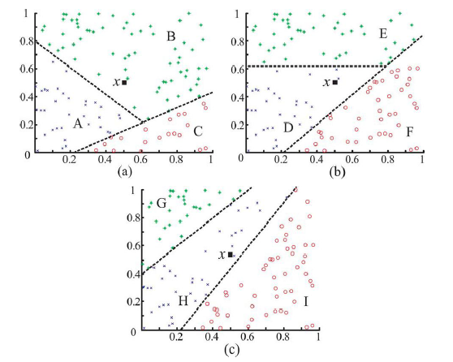
The Multitask Learning Problem (cont’d)
Example of multitask learning problem in pattern recognition
  Composed of 3 different three-class tasks (a), (b), and (c)

Slide 6
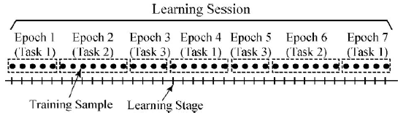
The Multitask Learning Problem (cont’d)
Goal
  After completion of learning session, the learning system should say, “for this problem, three tasks were learned and Task 1 consists of classes A, B, and C, Task 2 consists of classes D, E, and F and Task 3 consists of classes G, H, and I.”

Slide 7
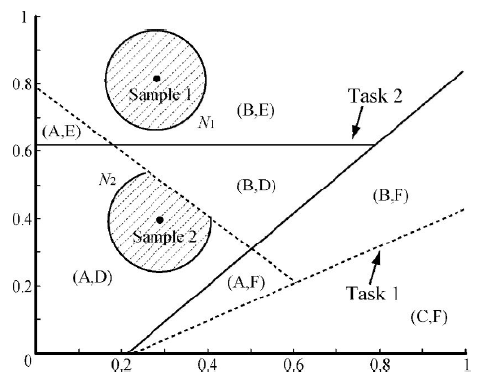
Knowledge Transfer
How to measure task relatedness?
  Measure the amount of overlap between classes of different tasks
  Transfer matching memory items from the previous classifier to the new classifier
  Optional approach: select most closely related classifier to compare against new classifier

Slide 8
Online Learning Algorithm
Three Main Parts
  One-pass online learning of classifiers
      Consists of Resource Allocating Network with Long-Term Memory (RAN-LTM)
      Prevents catastrophic forgetting
  Automated task recognition
      Implement Conflict Detector for task Re-Organization
  Knowledge transfer between tasks
      Transfer memory items from previous RAN-LTM

Slide 9
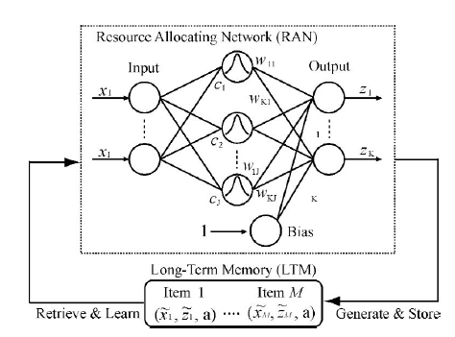
Online Learning Algorithm – RAN-LTM
Output node represents a class in a binary encoding scheme
  (0.1, 0.8, 0.1) = (0.1, θ, 0.1) corresponds to classes (A, B, C)
Input is a training point in a class
RAN uses a single-hidden-layer neural network structure and is similar to Radial Basis Function (RBF) networks.

Slide 10
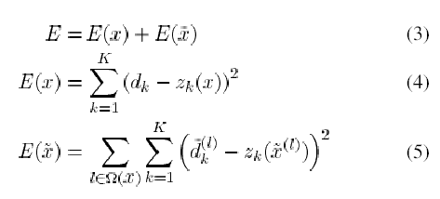
Online Learning Algorithm – Forgetting
Minimize total squared error for the new example and squared error for the retrieved neighboring memory items.
Ω(x) is the set of memory items in the neighborhood of x
K is the number of classes
z is the output vector from RAN
d is the class label

Slide 11
Online Learning Algorithm
– Knowledge Transfer
When there are several learned tasks that are related to the new one, it is important to choose the one most closely related to the knowledge transfer.
After detection of a task change, the algorithm transfers all memory items in the current RAN-LTM to the new RAN-LTM for the new task, but they remain inactive.
Memory items in overlapping areas are then activated.

Slide 12
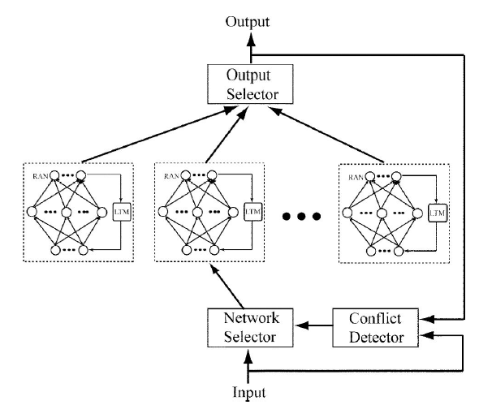
Online Learning Algorithm
– Automated Task Recognition
Task Recognition
  Implements squared error function to decide if task has been mapped to an RAN-LTM
  Can re-organize existing RAN-LTMs if a class has been associated to the wrong task
  Avoids the potential error in detection of class changes
    Uses queue q if a training example signals a potential for class change
      Indicated by large prediction error coupled with a new class not seen before
      Training of the current network is suspended and the current training example is temporarily stored in queue

Slide 13
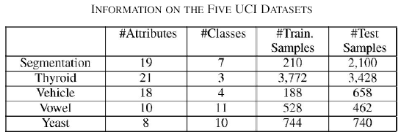
Experimental Evaluation
Evaluate
  Detection: whether new tasks are automatically recognized on an ongoing basis and training examples are assigned to the appropriate classifier (RAN-LTM) for the task
  Classification: whether knowledge transfer mechanism enhances the classification accuracy when an unknown task is presented
  Categorization: whether the mechanism for re-organizing classifiers works well and properly assigns classes to tasks
Source Data

Slide 14
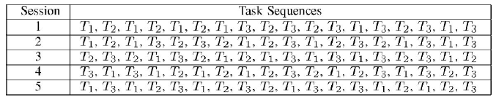
Experimental Evaluation – Input Data
Approach
  5 sessions
  Number of training examples in a training session is fixed at 720
  Number of training examples per epoch is varied from 10 to 80
  Number of epochs consequently varies from 9 to 72
Input Data

Slide 15
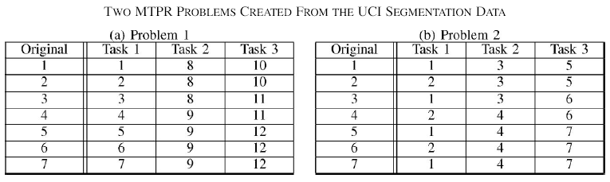
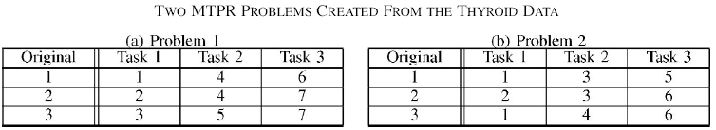
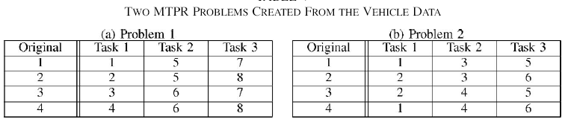
Experimental Evaluation – Problem Data
Classes divided among 3 tasks for 2 problems for each of 5 data sets

Slide 16
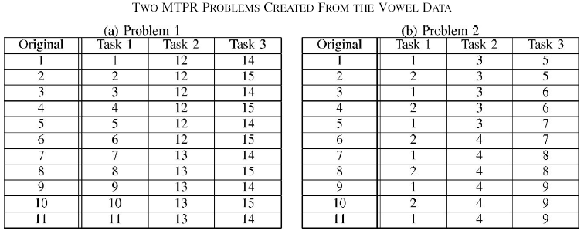
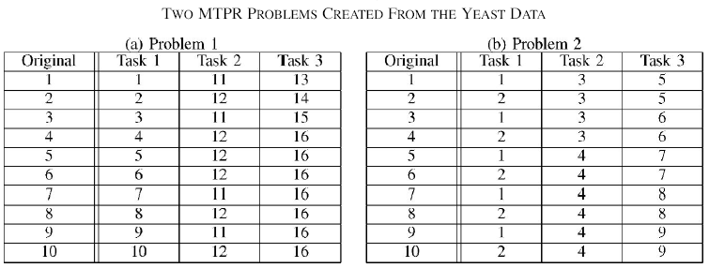
Experimental Evaluation – Problem Data
Classes divided among 3 tasks for 2 problems for each of 5 data sets

Slide 17
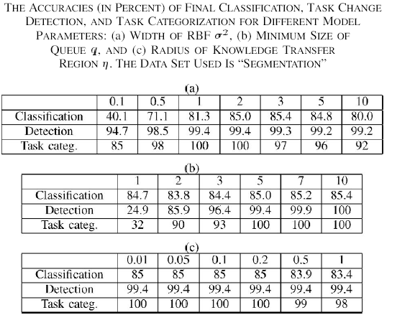
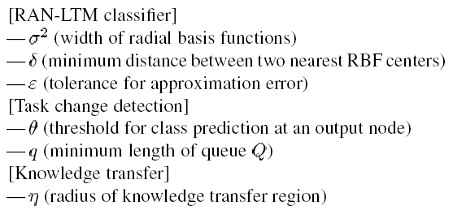
Experimental Evaluation - Results
Effect of varying input parameters
Fixed values:
  ᵟ = 1
  ε = 0.05
  θ = 0.5

Slide 18
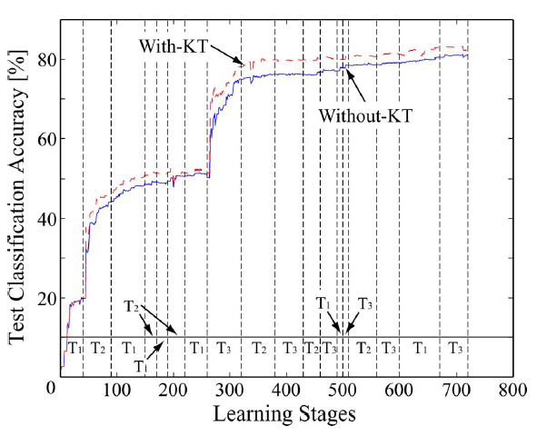
Experimental Evaluation
– Test Classification Accuracy
With and without knowledge transfer

Slide 19
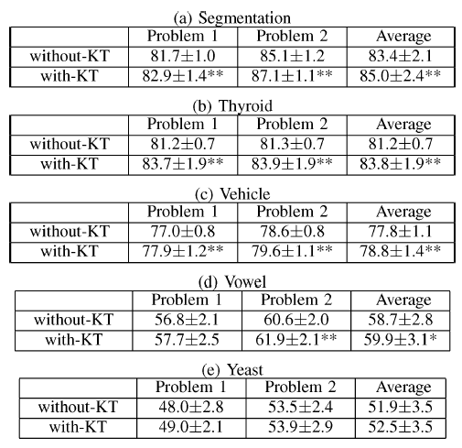
Experimental Evaluation
- Test Classification Accuracy (cont’d)
Final classification accuracies

Slide 20
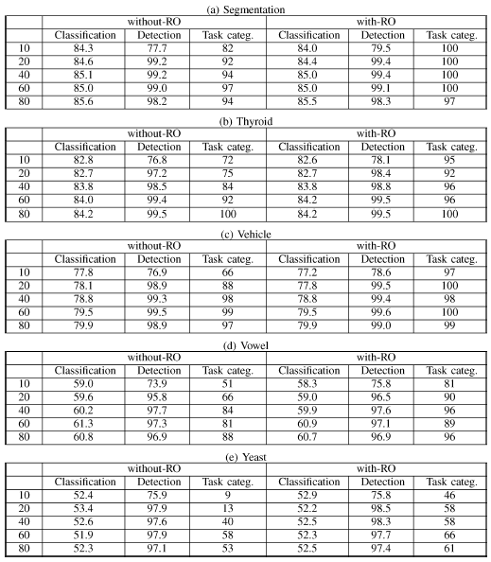
Experimental Evaluation
- Re-organization
Results of classification, detection, task categorization with and without re-organization

Slide 21
Conclusions
Observations
  Task recognition works very well unless the number of training examples is too small
  Classifier re-organization greatly improves task categorization accuracy for all MTPR problems
  Algorithm is first step towards developing a completely automated multitask learning system for artificial robots
Challenges & Future Work
  Resolve the problem of having to predefine different parameters for this algorithm
  Need more robustness for the task-change detection part and the re-organization process
    If the presentation order of classes is strongly biased, the possibility of misdetection of task changes would be increased
  The proposed multitask learning model should also have the ability to extract features on an ongoing basis

Slide 22
Thanks!

